Slide 1

E-Commerce Sales Analytics Platform
End-to-End Data Engineering & Business Intelligence Solution
Source Data
Azure (ADF / ADLS)
Databricks Bronze
dbt Silver/Gold
Gold Star Schema
Dashboards
Project: Enterprise E-Commerce Analytics Delivery
Orchestration: Apache Airflow | Quality: Pytest | Alerts: Slack
Anish Kumar
Manjunatha
Keerthana
Pathan
Pusphavathi
Tejas

Slide 2
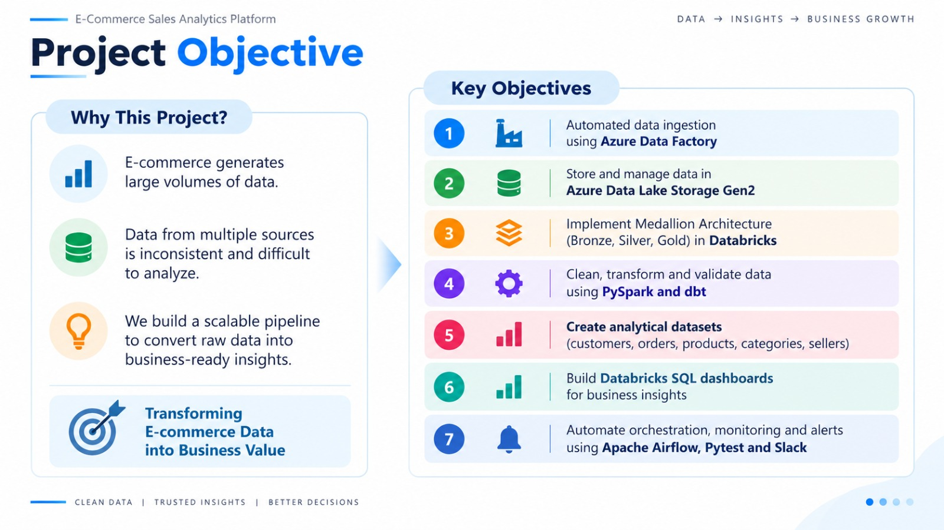

Slide 3
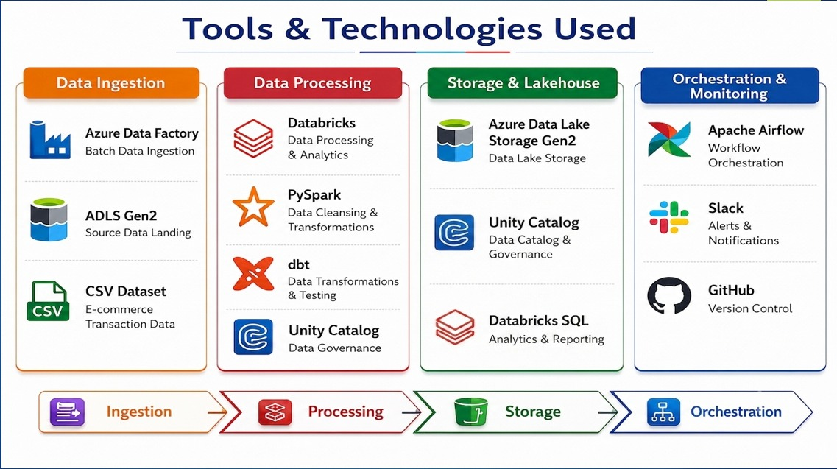

Slide 4
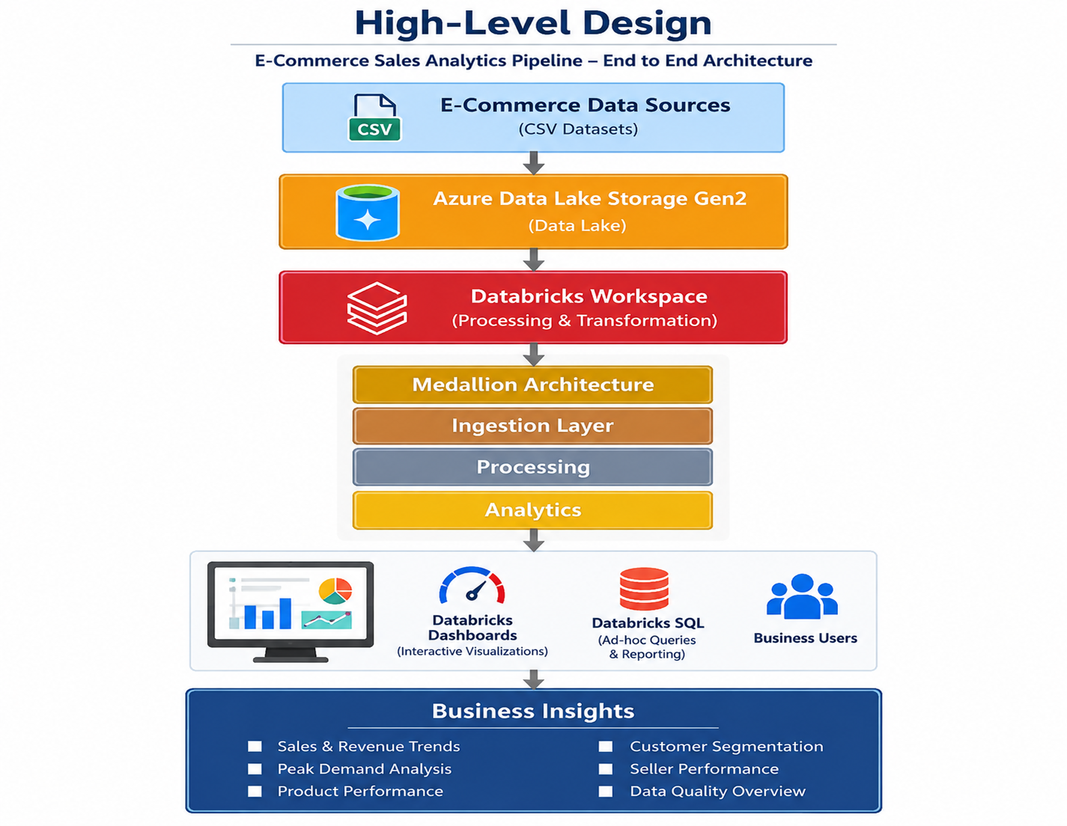

Slide 5
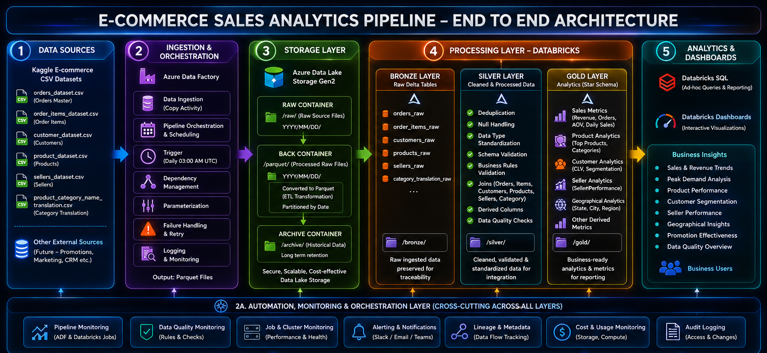
Low Level Architecture

Slide 6
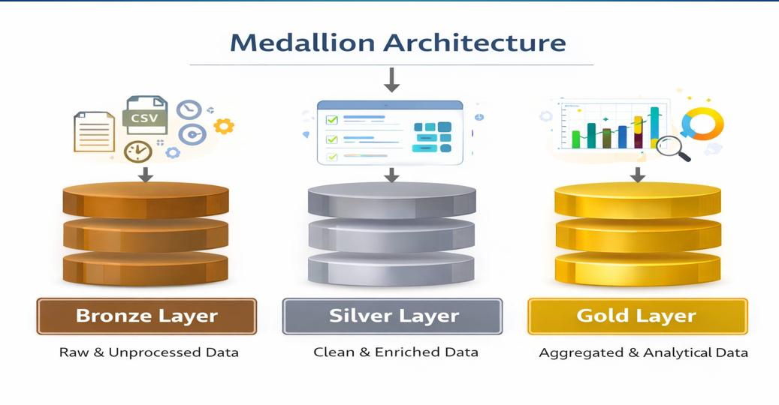

Slide 7










Data Ingestion & Azure Data Lake Storage
Source CSV Feeds
Azure Data Factory
ADLS Gen2 Container
Raw E-Commerce Snapshots
Batch Ingestion & File Movement
Scalable Storage / Bronze Delta
Six Ingested E-Commerce Core Datasets:
Customers
Orders
Order Items
Unique customer IDs, customer zip code prefixes, customer cities, and Brazilian customer state geographies.
Order IDs, customer IDs, purchase timestamps, approval timestamps, carrier handoff, delivered dates, and order status.
Individual line items, order sequence IDs, product keys, seller keys, item unit prices, and freight shipping charges.
Products
Sellers
Category Translation
Product identifiers, category names, physical dimensions (length, height, width), package weight, and photos quantity.
Merchant seller identifiers, regional seller zip code prefixes, seller fulfillment cities, and seller states.
Cross-lingual mapping translating localized Portuguese source product category strings into clean English attributes.
Azure Data Factory:
ADLS Gen2 Central Storage:
Databricks Mounts:

Slide 8






Silver Layer — Data Quality & Business Transformation
Bronze Ingest
Cleaning
Validation
Joining
Enrichment
Silver Conformed
Silver Customers
Silver Orders
Silver Order Items
•
Removes duplicate customer records using window functions.
•
Parses timestamps into UTC timestamps; handles format discrepancies.
•
Validates non-negative price and freight values.
•
Validates 32-character hexadecimal customer IDs.
•
Casts item sequential identifiers to standard integers.
•
Standardizes city names (lowercasing, trimming accents) and uppercase 2-letter state codes.
•
Standardizes order statuses (delivered, shipped, canceled).
•
Calculates total transaction value (item price + freight cost) at line-item granularity.
•
Calculates derived logistics: purchase-to-delivery lead time in days and delivery delay intervals.
Silver Products
Silver Sellers
Silver Category Translation
•
Validates dimensions (length, height, width, weight in grams).
•
Validates unique seller UUID keys against duplicates.
•
Maps Portuguese product category strings to conformed English names.
•
Replaces null categories with standardized 'Unknown' tags.
•
Standardizes seller geographic locations and zip prefix codes.
•
Cleans product name length and description character counts.
•
Conforms seller state representations for unified regional analytics.
•
Establishes clean cross-reference dimension keys for gold joins.
•
Applies default fallback values for newly observed source categories.

Slide 9




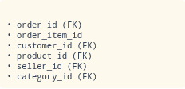
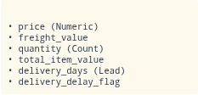



Gold Layer — Business-Ready Star Schema
High-performance dimensional model centered on fact_order_items, optimized for low-latency BI aggregations.
dim_customer Dimension
dim_product Dimension
• customer_id (PK) • customer_city, state • customer_segment
• product_id (PK) • product_weight_g • product_dimensions
fact_order_items
Foreign Keys (FK)
Metrics & Measures
dim_order Dimension
dim_product_category Dimension
• order_id (PK) • order_status • purchase_timestamp
• product_category_name (PK) • english_category_name • category_group
dim_seller Dimension
BI Optimization
• seller_id (PK) • seller_city, state • seller_zip_code_prefix
Structured strictly as a Star Schema to support direct slice-and-dice operations across commercial reporting tools.

Slide 10
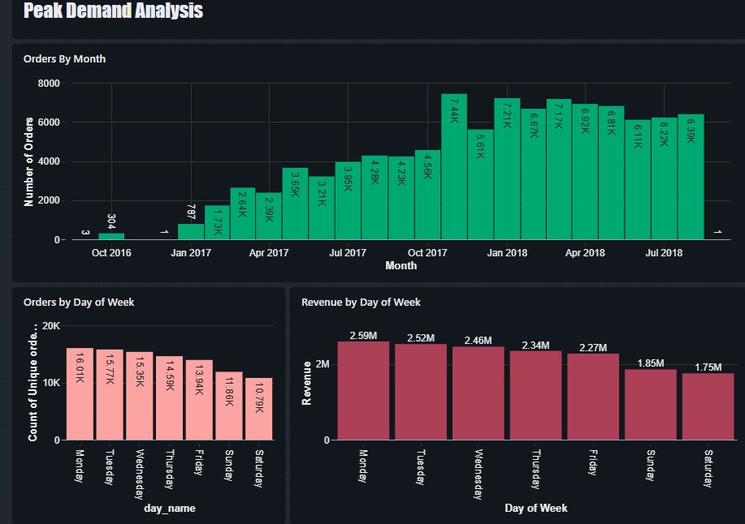
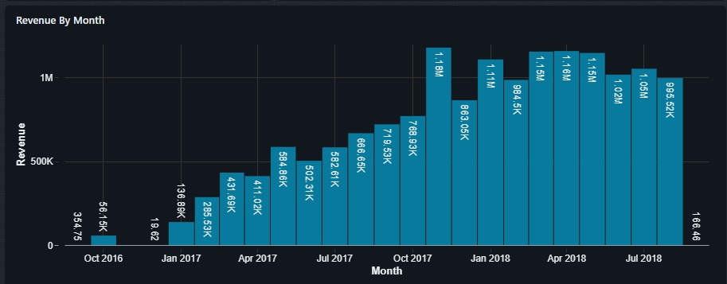
Databricks Dashboard — Executive Sales & Demand
Executive Sales Overview
Orders & Revenue by Day
16.1%
16.8%
16.3%
15.2%
14.8%
10.9%
9.9%

Slide 11
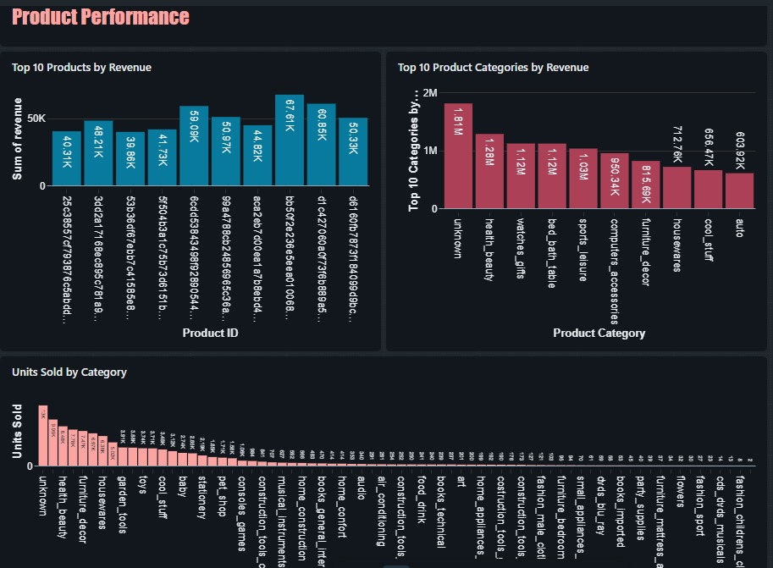
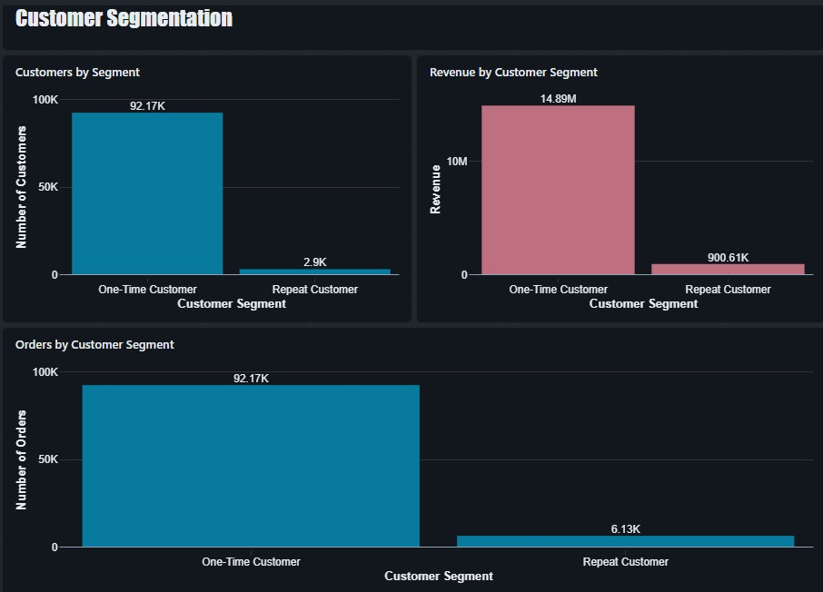

Slide 12
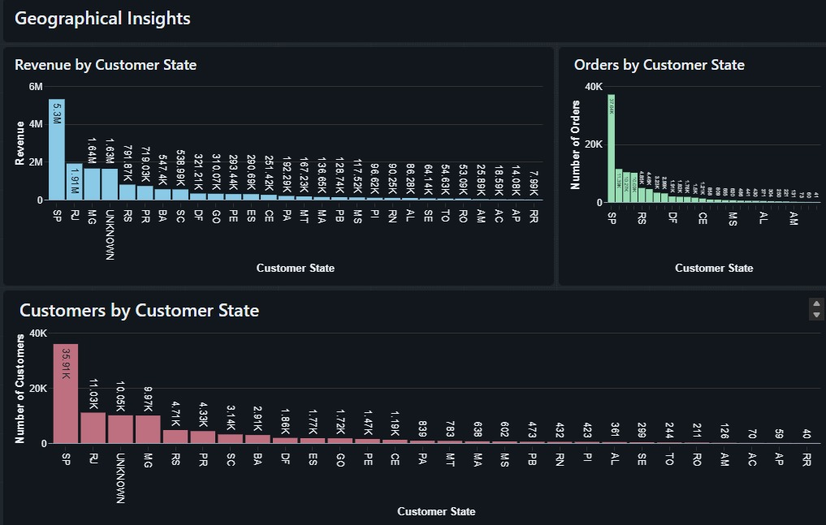

Slide 13





Business Value Delivered & Key Questions Answered
Sales Performance
Customer Intelligence
Products & Sellers
Operational Fulfillment
Delivers automated visibility into revenue trajectories, order growth, and average order values without manual compilation.
Segments customer base by order frequency, distinguishing first-time buyers from repeat loyal cohorts.
Identifies top volume categories and isolates merchant partners with exceptional fulfillment throughput.
Monitors carrier delivery lead times, identifies shipping bottlenecks, and tracks delay flags by geographic zone.
Five Critical Executive Questions Directly Answered by the Platform:
Are sales growing? Yes; verified monthly revenue trajectories showcase steady year-over-year gains and strong Q4 promotional surges.
Which markets should the business focus on? Focus on São Paulo (42%) and Southeast Brazil while expanding shipping efficiency into outlying states.
Which products and categories drive sales? Bed, Bath & Table, Health & Beauty, and Sports & Leisure drive core revenue and order volume.
Are there delivery problems? Delivery duration averages 12.5 days; outlier delays are flagged automatically at row-level for operational triage.
Are customers coming back? Currently ~3.1% repeat purchase rate, establishing a proven analytical baseline for customer retention campaigns.

Slide 14
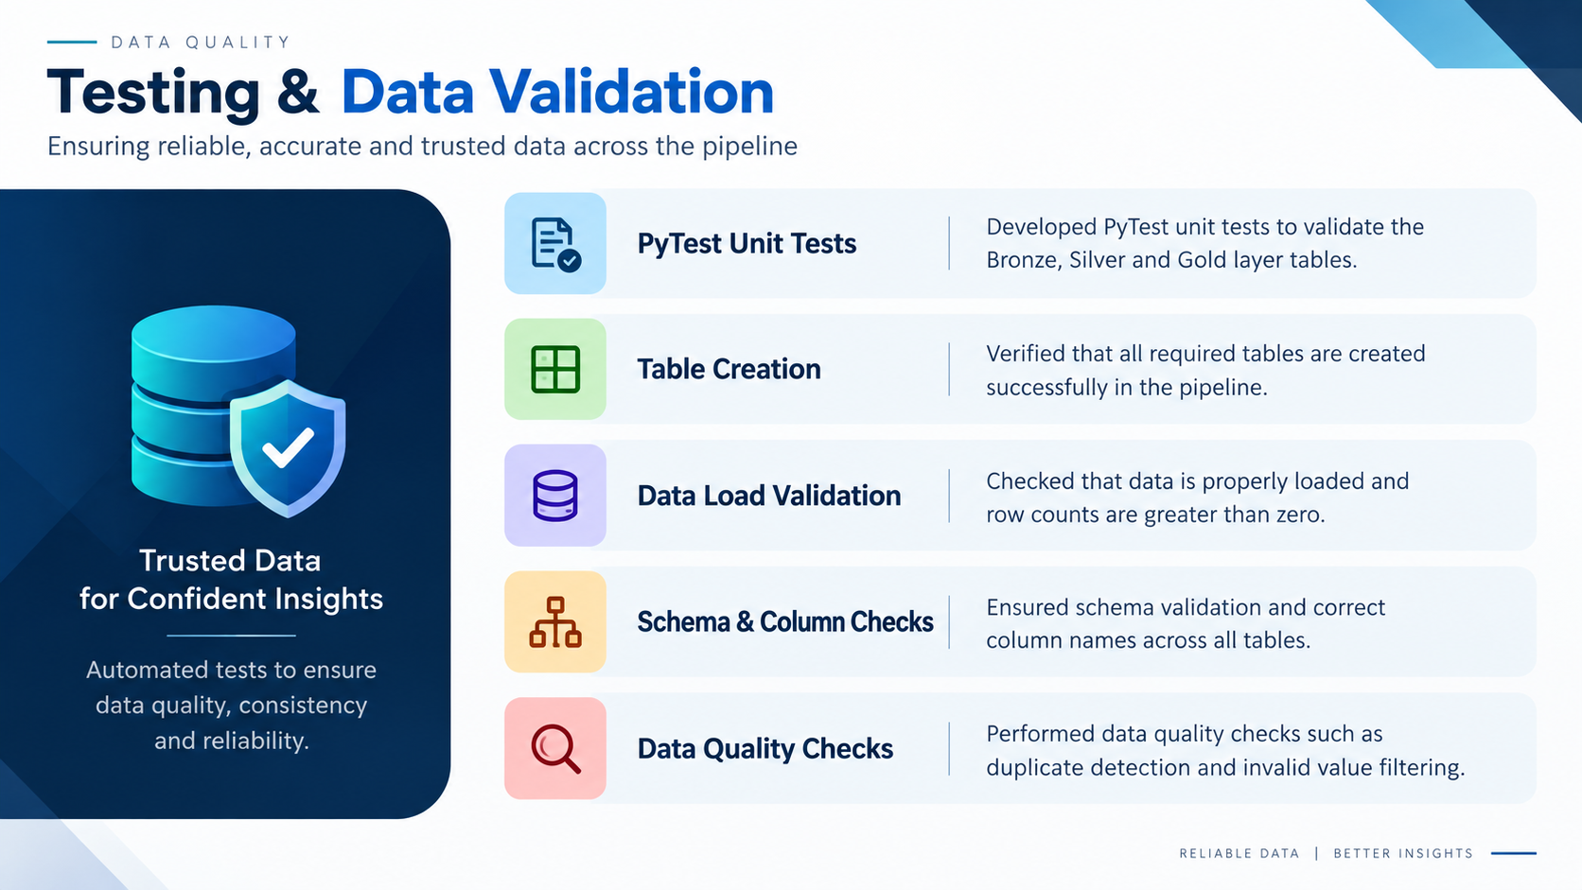

Slide 15
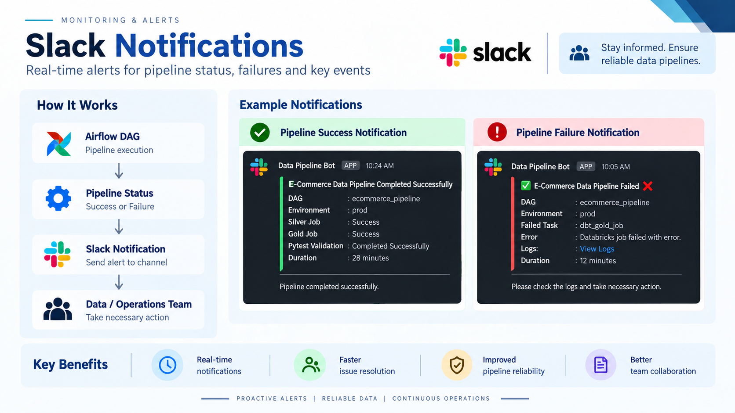

Slide 16








Airflow — End-to-End Pipeline Orchestration
Production Airflow DAG Execution Flow
Start DAG
Bronze
dbt Silver
dbt Gold
Pytest Suite
Success / End
Schedule Trigger
dbt Cloud Job
Star Schema Job
Databricks Job
Pipeline Cleared
Orchestration Capabilities:
Slack Automated Operational Webhooks
•
On Pipeline Success:
Task Dependency Enforcement: Ensures Gold models only build upon verified Silver outputs.
Broadcasts pipeline runtime, row counts, and test passage to #data-ops.
•
dbt Cloud Execution: Triggers API runs on dbt Cloud and polls completion states asynchronously.
•
Databricks Validation Integration: Spawns ephemeral Databricks testing jobs to execute Pytest checks.
On Failure Callback:
•
Automated Retries: Handles intermittent network or cluster spin-up timeouts gracefully.
Triggers instant alert with task ID, error log snippet, and retry link.

Slide 17



Final Platform Outcome & Strategic Impact
Source CSVs
ADF & ADLS Gen2
Bronze
Silver Cleansed
Gold Star Schema
Databricks BI
Centralized Platform
Medallion Standard
Clean Silver Layer
Gold Star Schema
Unified repository eliminating fragmented CSVs.
Bronze raw to Gold business-ready progression.
Deduplicated records with parsed timestamps.
Optimized fact and conformed dimensions.
Dashboard Ready
Airflow Automated
Automated Pytest
Commercial Sales BI
Pre-aggregated measures enabling zero runtime joins.
Complete DAG execution and Slack status webhooks.
43/46 tests passing quality gate before serving.
Verified commercial decisions for leadership.
“The platform transforms raw e-commerce data into trusted, actionable business insights through a scalable and automated analytics architecture.”

